Slide 1
Implementation of SHA-1 and SHA-2 Algorithms on Reconfigurable Hardware

Slide 2
Agenda
Introduction
SHA-1 Algorithm
SHA-1 Architecture
SHA-2 Algorithm
SHA-2 Architecture

Slide 3
Introduction
Growth rate for e-commerce has been double-digit over the last decade, with an estimated $301 billion expected Online retail sales in 2012 [1].
This extreme increase in online trading has lead to a rise in online attacks to obtain money through deception or other illegal means [2].
Due to this, companies and consumers have become more aware of security risks exchanging information over such an open medium,
leading to several third parties setting up secure areas for credit card and bank account details to be shared with minimal risk of the numbers being obtained and used fraudulently.

Slide 4
Introduction
Major credit companies such as Visa and MasterCard have set up subsidiaries such as Verified by Visa to give consumers confidence that the sites they are buying from are safe.
These “security seals” are becoming more common on commercial sites, as customers have been found to avoid purchasing from companies who do not use them [3].
When shopping on The Internet, a connection is set up between the computer being used and the company server using a “Challenge and Response” through the
Transport Layer Security (TLS), or its predecessor Secure Sockets Layer (SSL) [4].

Slide 5
Purpose: Authentication Not Encryption
Introduction
Authentication Requirements:
  Masquerade – Insertion of message from fraudulent source
  Content Modification – Changing content of message
  Sequence Modification – Insertion, deletion and reordering sequence
  Timing Modification – Replaying valid sessions

Slide 6
Introduction
Cryptography provides powerful mechanisms to protect data
But it carries a relatively high cost in terms of computing power.
Even the largest of commercial transaction processing systems are likely to deteriorate to a halt if all transactions require strong cryptography.

Slide 7
Introduction
Increasing the speed of the server itself, or adding additional parallel server systems often become too costly solutions for this problem.
Designing special hardware architectures to carry out cryptographic functions at commercial speed enables the infrastructure for world-wide electronic commerce where data integrity assurance and data origin authentication are essential security services.

Slide 8
Contd.
A promising solution which combines high flexibility with the speed and physical security of traditional hardware is the implementation of cryptographic algorithms on reconfigurable devices such as FPGAs.
Traditional ASIC solutions, on the other hand, have the well-known drawback of reduced flexibility compared to software solutions.
Reconfigurable hardware devices such as Field Programmable Gate Arrays (FPGAs) are an appealing alternative for the implementation of cryptographic algorithms.
Their advantages combine flexibility and ease of upgrade (modification of software implementations) with the improved physical security and performance that characterize hardware implementations. In addition, the time and cost of FPGA design are smaller than in other hardware approaches (ASIC).

Slide 9
Hash Features
Hash functions reduce variable-length input to fixed-length (128 or 160 bit) output.
They are also called message digest or fingerprints.
And they have to fulfill the following requirements:
input cannot be deduced from output
A given output cannot be generated
Two inputs which produce the same output cannot be found
Hash algorithms are used to produce:
fixed-length fingerprint of arbitrary length data
data checksums to enable detection of modifications

Slide 10
What does a hash do?
Provide a 'checksum' of a file of information
Used to verify the integrity of that information
16 Mbyte Delhi Stock Exchange
16 Mbyte Mumbai Stock Exchange
data
Transmit Data + Hash
data
Hash
Hash
==?
160 bits
160 bits
Data is Correct !

Slide 11
What is a good hash function?
Standard Criteria:
  Must deliver good compression, e.g. 16MByte -> 160bits
  Must be easy to compute
For integrity applications we also need:
  One-way: given the hash, you cannot find the original message
  Weak Collision Resistance: For a given message and hash, it must be hard to find another message with the same hash
  Strong Collision Resistance: It must be hard to find any two messages with the same hash

Slide 12
Why a one-way hash?
Assume that Tracey, Carl and Carol are doing online bidding on a bulletin board (B.B.).
They post their bid as a messages to the BB.
How can we keep their bid confidential while preventing cheating?
Answer - They post a hash of their bid amount. This way, everyone is sure that everybody else has done a bid. After bids are posted, Tracey, Carl and Carol reveal their unhashed bid amount. The winning bid can now be selected, and verified by the others.

Slide 13
SHA
SHA = Secure Hash Algorithm
Designed by NSA, standardized by NIST
Several different versions of this algorithm exist
  SHA-0 (1993): no longer used
  SHA-1 (1995): 160-bit output
SHA-1 is extensively used in internet security protocols
  SSL, SSH, PGP
  Documentation of SHA-1: FIPS 180-1
SHA-1 is partially compromised
  Still in use, but will be replaced with new hash algorithms
  In October 2008, NIST will initiate competition for a new hash

Slide 14
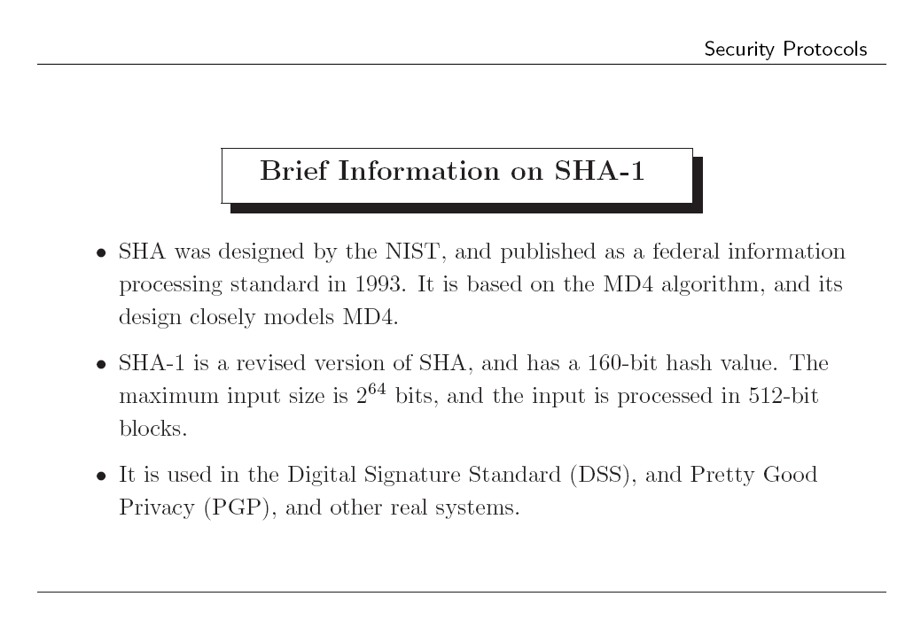
SHA-1 Algorithm

Slide 15
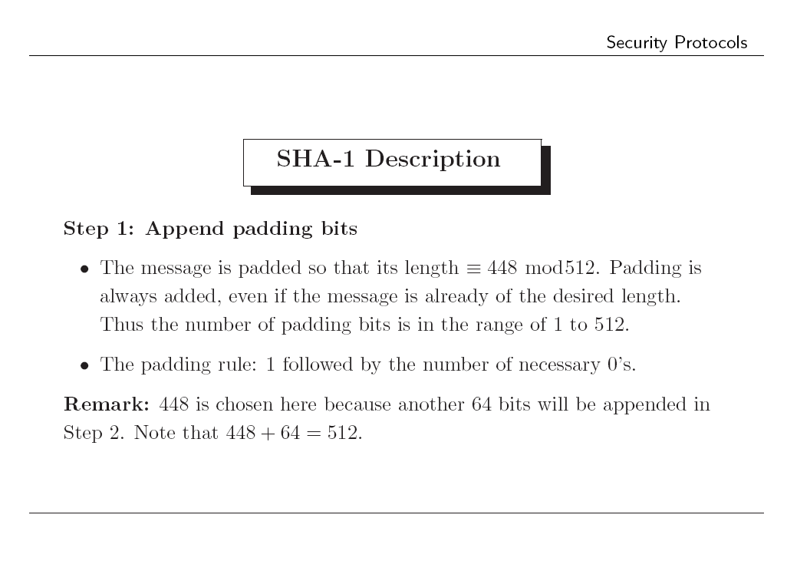

Slide 16
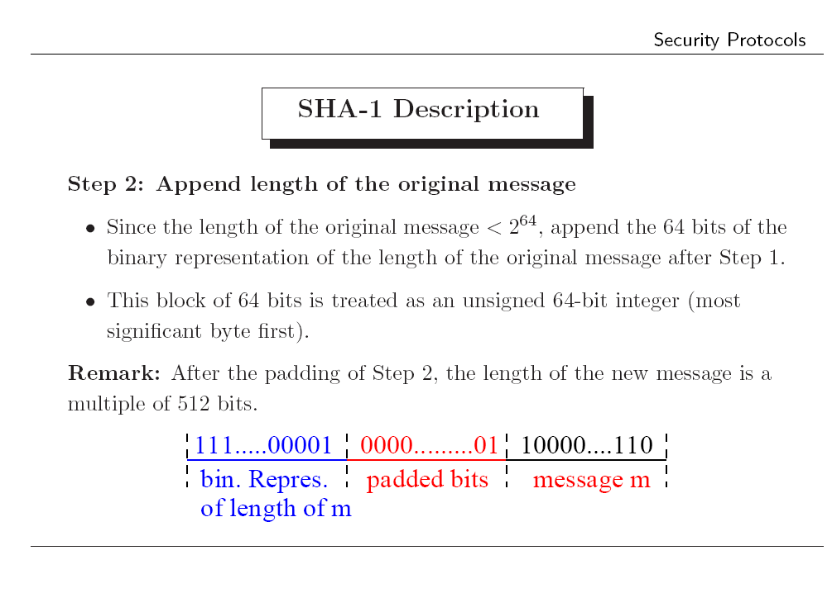

Slide 17
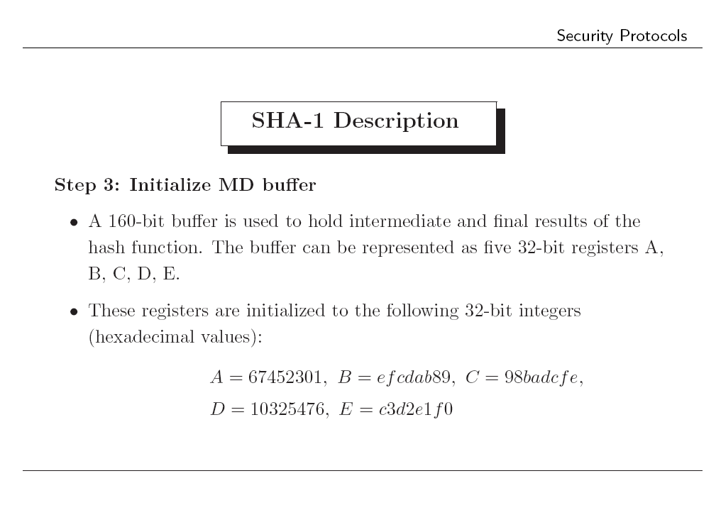

Slide 18
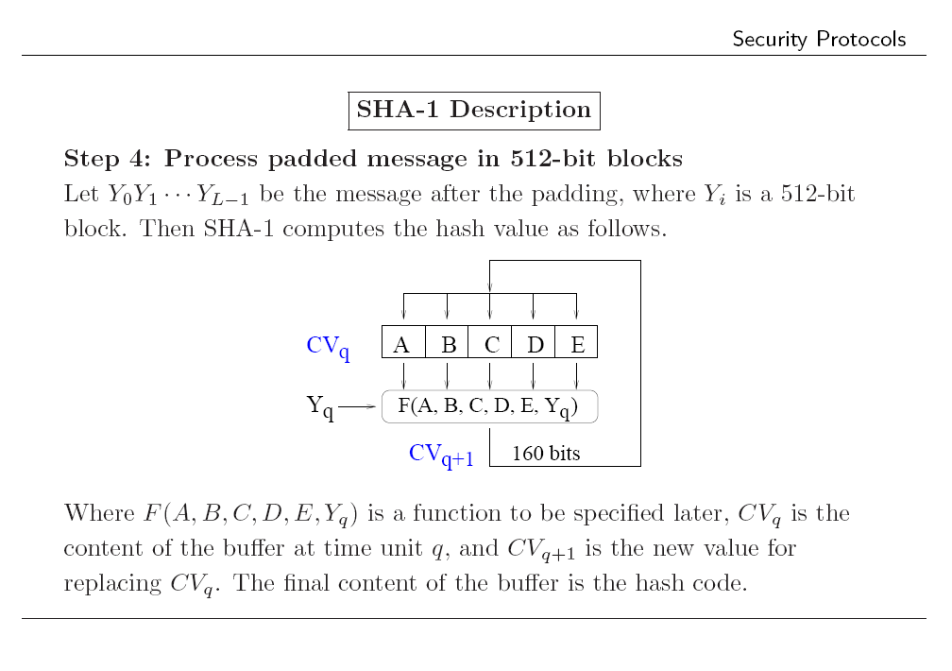

Slide 19
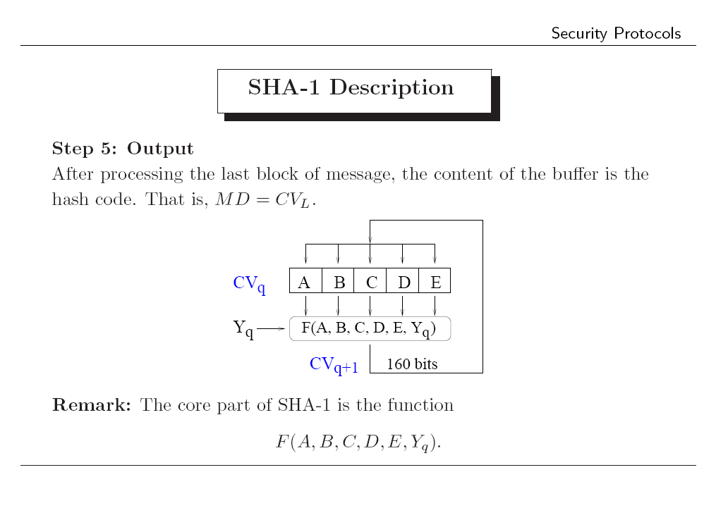

Slide 20
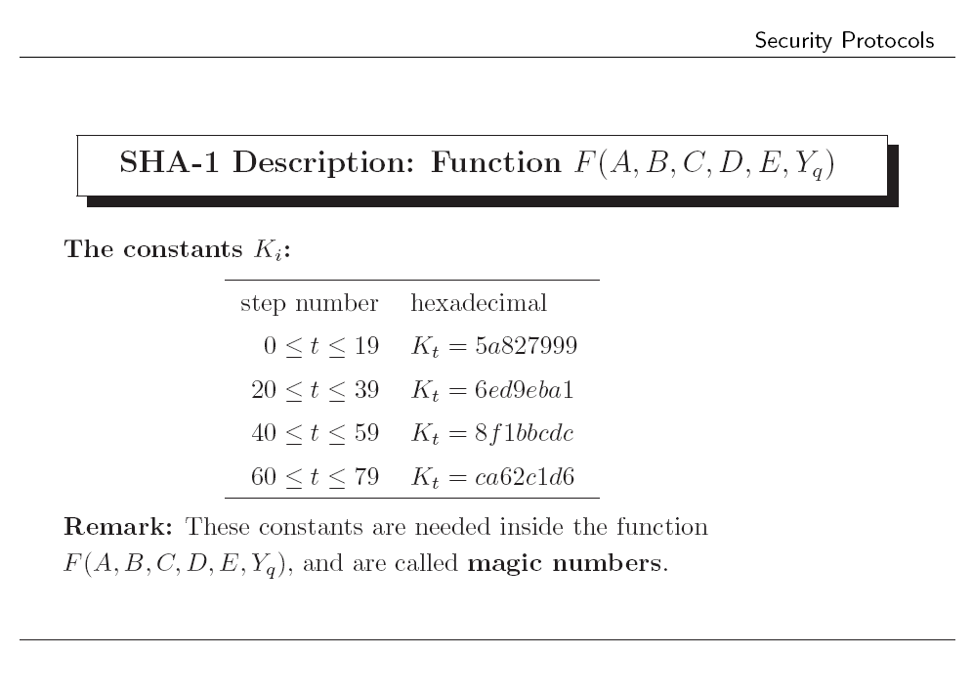

Slide 21
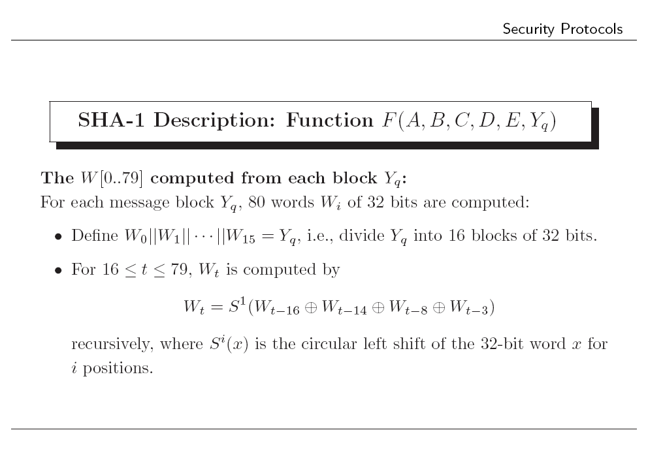

Slide 22
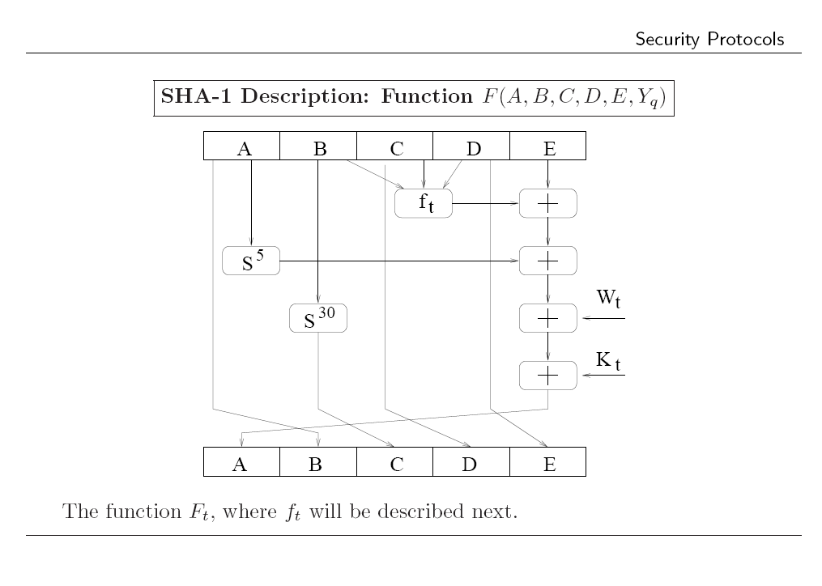

Slide 23
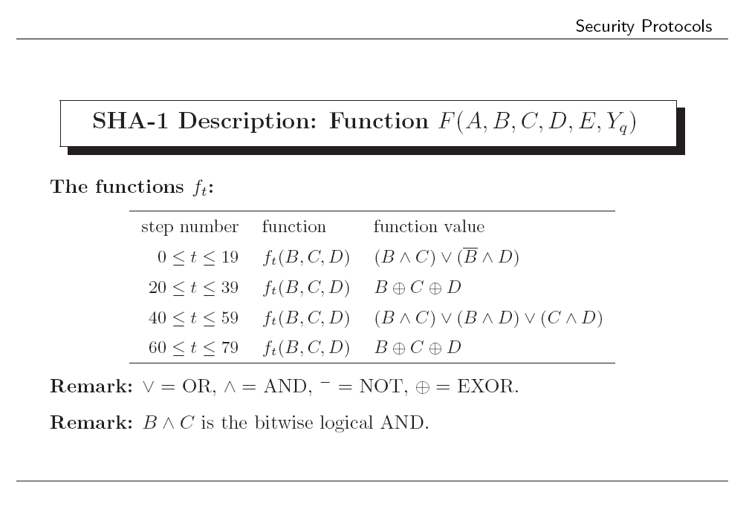

Slide 24
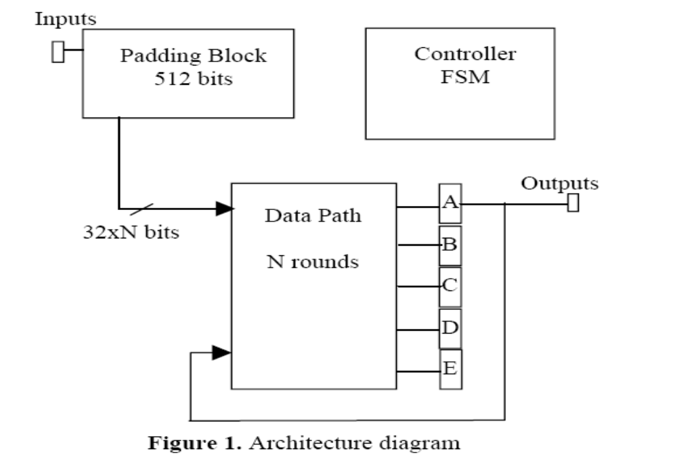
SHA-1 Architecture

Slide 25
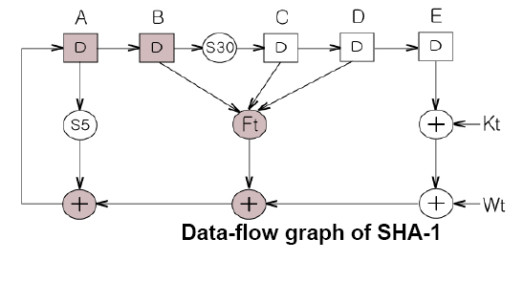
Contd.

Slide 26
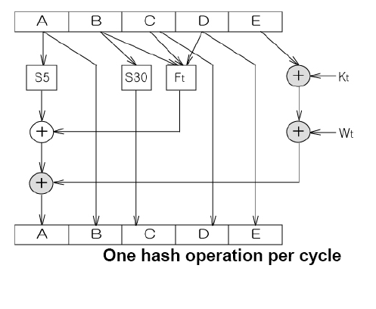
Contd.

Slide 27
SHA-2 Algorithms

Slide 28
Flavors of SHA
SHA-0
SHA-1
SHA-2
  SHA-224
  SHA-256
  SHA-384
  SHA-512
Longer hash value = more secure

Slide 29
SHA-512
Step 1: Append padding bits
Step 2: Append length
Step 3: Initialize hash buffer
Step 4: Process the message in 1024-bit (128-word) blocks, which forms the heart of the algorithm
Step 5: Output the final state value as the resulting hash

Slide 30
SHA-512 Compression Function
heart of the algorithm
processing message in 1024-bit blocks
consists of 80 rounds
  updating a 512-bit buffer
  using a 64-bit value Wt derived from the current message block
  and a round constant based on cube root of first 80 prime numbers

Slide 31
Function Elements
Ch(e,f,g) = (e AND f) XOR (NOT e AND g)
Maj(a,b,c) = (a AND b) XOR (a AND c) XOR (b AND c)
∑(a) = ROTR(a,28) XOR ROTR(a,34) XOR ROTR(a,39)
∑(e) = ROTR(e,14) XOR ROTR(e,18) XOR ROTR(e,41)
+ = addition modulo 2^64
  Kt = a 64-bit additive constant
  Wt = a 64-bit word derived from the current 512-bit input block.

Slide 32
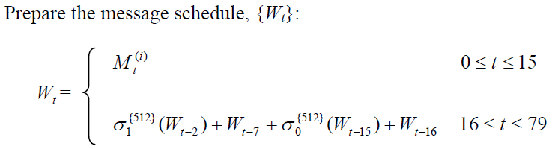


Slide 33
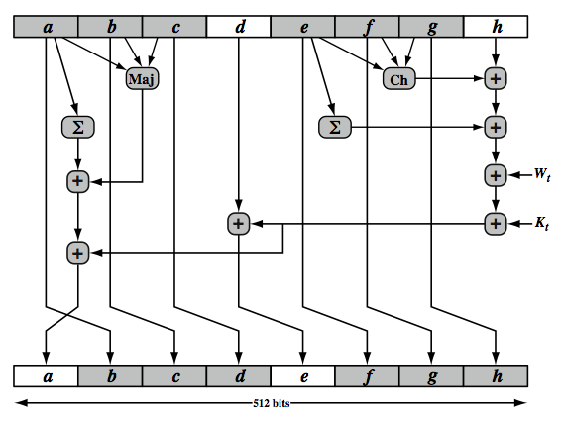
SHA-512 Round Function

Slide 34
References
[1] C. I. Tangpong, Muhammad ; Lertpittayapoom, Nongkran "The Emergence of Business-to-Consumer E-Commerce," Journal of Leadership & Organizational Studies, vol. 16, pp. 131-140, 2009.
[2] R. R. Dube, Hardware Based Computer Security Techniques to Defeat Hackers. Hoboken NJ: John Wiley and Sons, 2008.
[3] B. C.-T. Ho, and Kok-Boon Oh, "An empirical study of the use of e-security seals in e-commerce," Online Information Review, vol. 33, pp. 655-671, 2009.
[4] J. Seberry and J. Pieprzyk, Cryptography : an introduction to computer security. New York ; London: Prentice Hall, 1989.

Slide 35
Any Queries
?

Slide 36
Thank you!

